Slide 1

PROJECT PRESENTATION
MAHARAJA SURAJMAL INSTITUTE OF TECHNOLOGY
MADE BY:- ANKIT SINGH PATEL

Slide 2

Project: Women Safety Application
Objectives:
To ensure safety of women using AI/ML
To take necessary measures in time of need

Slide 3
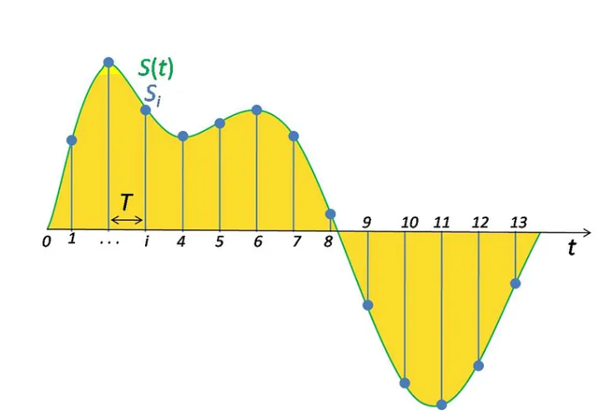
HOW TO REPRESENT SOUND DIGITALLY

Slide 4
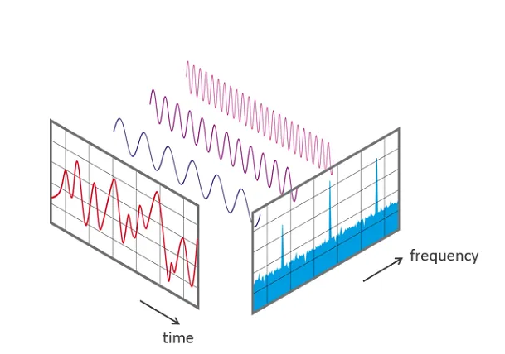
SIGNAL ANALYSIS

Slide 5
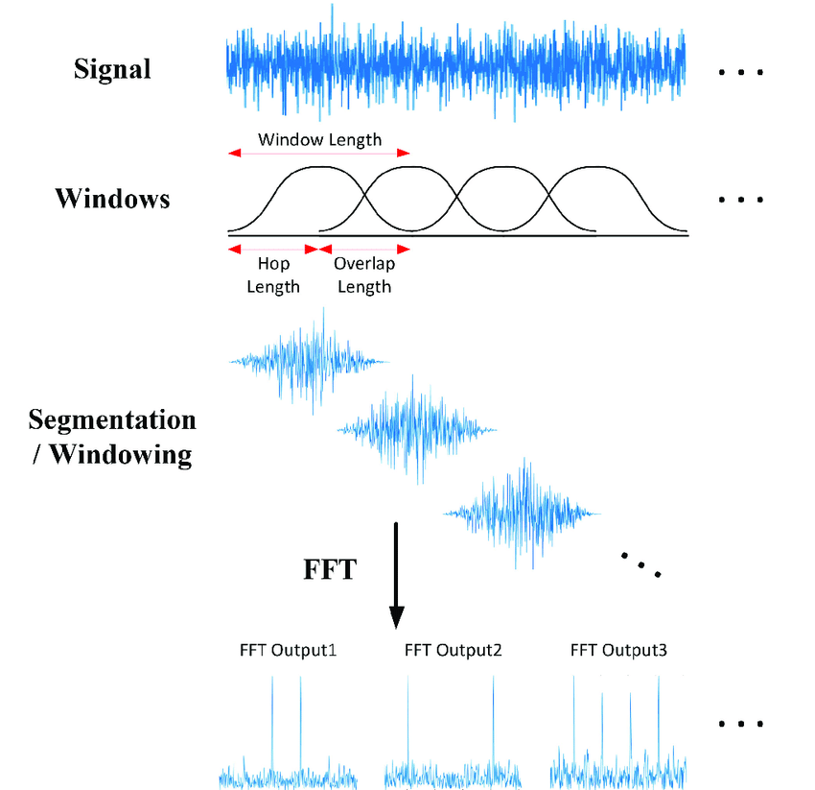
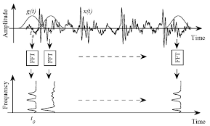
SHORT-TIME FOURIER TRANSFORM

Slide 6
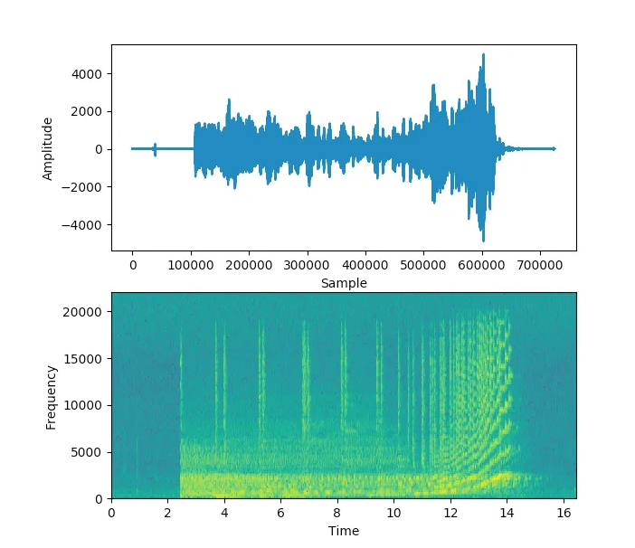
SPECTROGRAMS

Slide 7
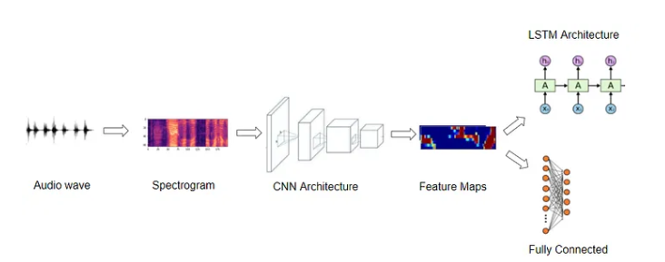
DEEP LEARNING MODEL
CNN
DNN
HMM

Slide 8
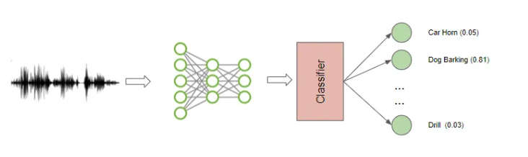
AUDIO CLASSIFICATION

Slide 9
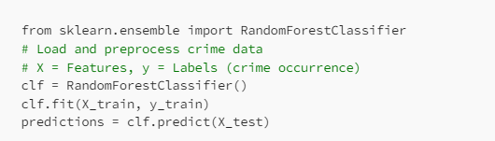
Predictive Policing and Hotspot Detection

Slide 10
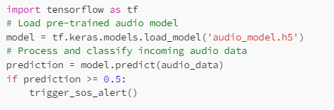
Personal Safety Apps with SOS Features

Slide 11
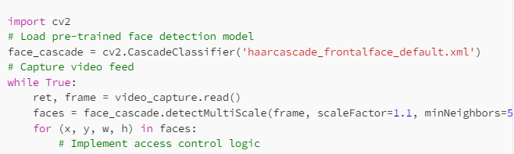
Facial Recognition for Access Control

Slide 12

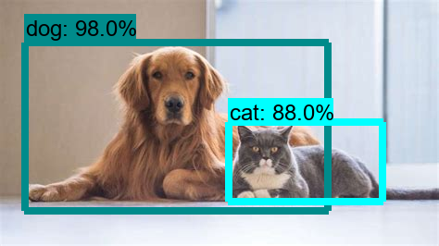
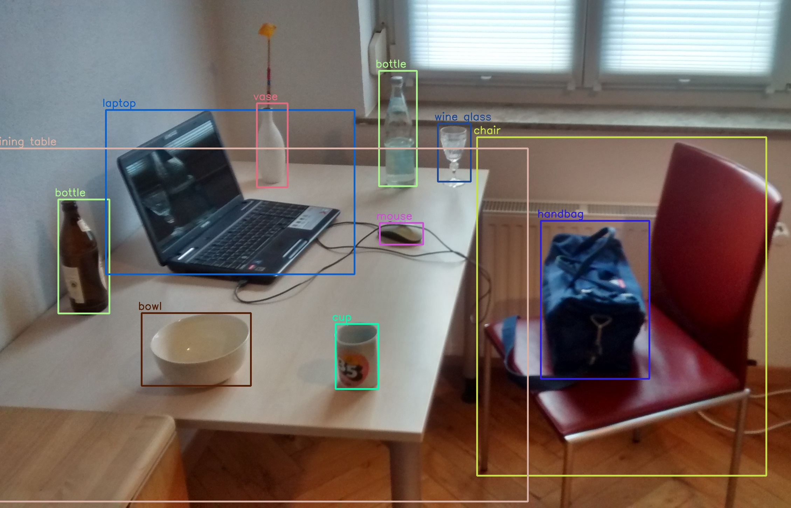
Object Detection
Detects the objects on which it is trained
More training results in more accuracy

Slide 13

Location Tracking Using GPS

Slide 14
THANK YOU

